Slide 1
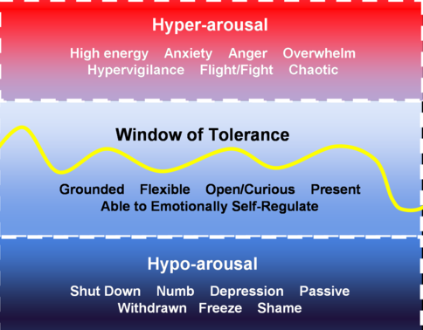

Slide 3
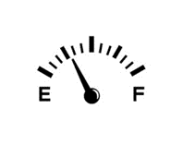
BEST Check-in. How am I doing IN THIS MOMENT?
Body physical self what you would tell a doctor Eg. energy level, pain, hunger, soreness, tension | Spirit spiritual self our sense of connection to God, the world, nature, others sense of groundedness, presence in this moment Eg. grounded, present, lost, searching, disconnected, isolated, connected
Emotion ‘heart’ self tune into one or two emotions you’re holding in this moment Eg. anxious, happiness, weariness, grateful, annoyed, content, anger, excitement | Thoughts cognitive self describe my thoughts/one thought I can ‘catch’ Focused, scattered, racing, jumbled, present, disjointed, anxious

Slide 4
Stressor
What is in my control?
What is not in my control?
Action
Acceptance/Prayer

